Slide 1
Oncology Center Services and Prediction Techniques
to Assist in Making Right Decision.
Under Supervision of
Prof. Dr.Elsayed Badr
Eng:Mohamed Alhakim

Slide 2
Team Members
Alaa Walid Mohamed Alshitany
Eman Tarek Taha Ali
Basma Talaat Mahmoud Mohamed
Abdelrahman Ahmed Abdelhady
Yara Ahmed Mohamed Swisa

Slide 3
Agenda
Introduction
Problems and Solutions
Analysis
Model
Results
Implementation
Future Work
Summary

Slide 4

Introduction
- Difference between Oncology and Cancer.
-Oncology: a branch of medicine that deals with the study, treatment, diagnosis, and prevention of cancer.

Slide 5
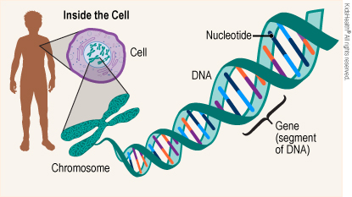
Normal Cell
- In our body we have trillions of cells.
- Each cell has millions of DNA.
- Each group of DNA forms genes which carry instructions that tell your cells how to work and grow

Slide 6
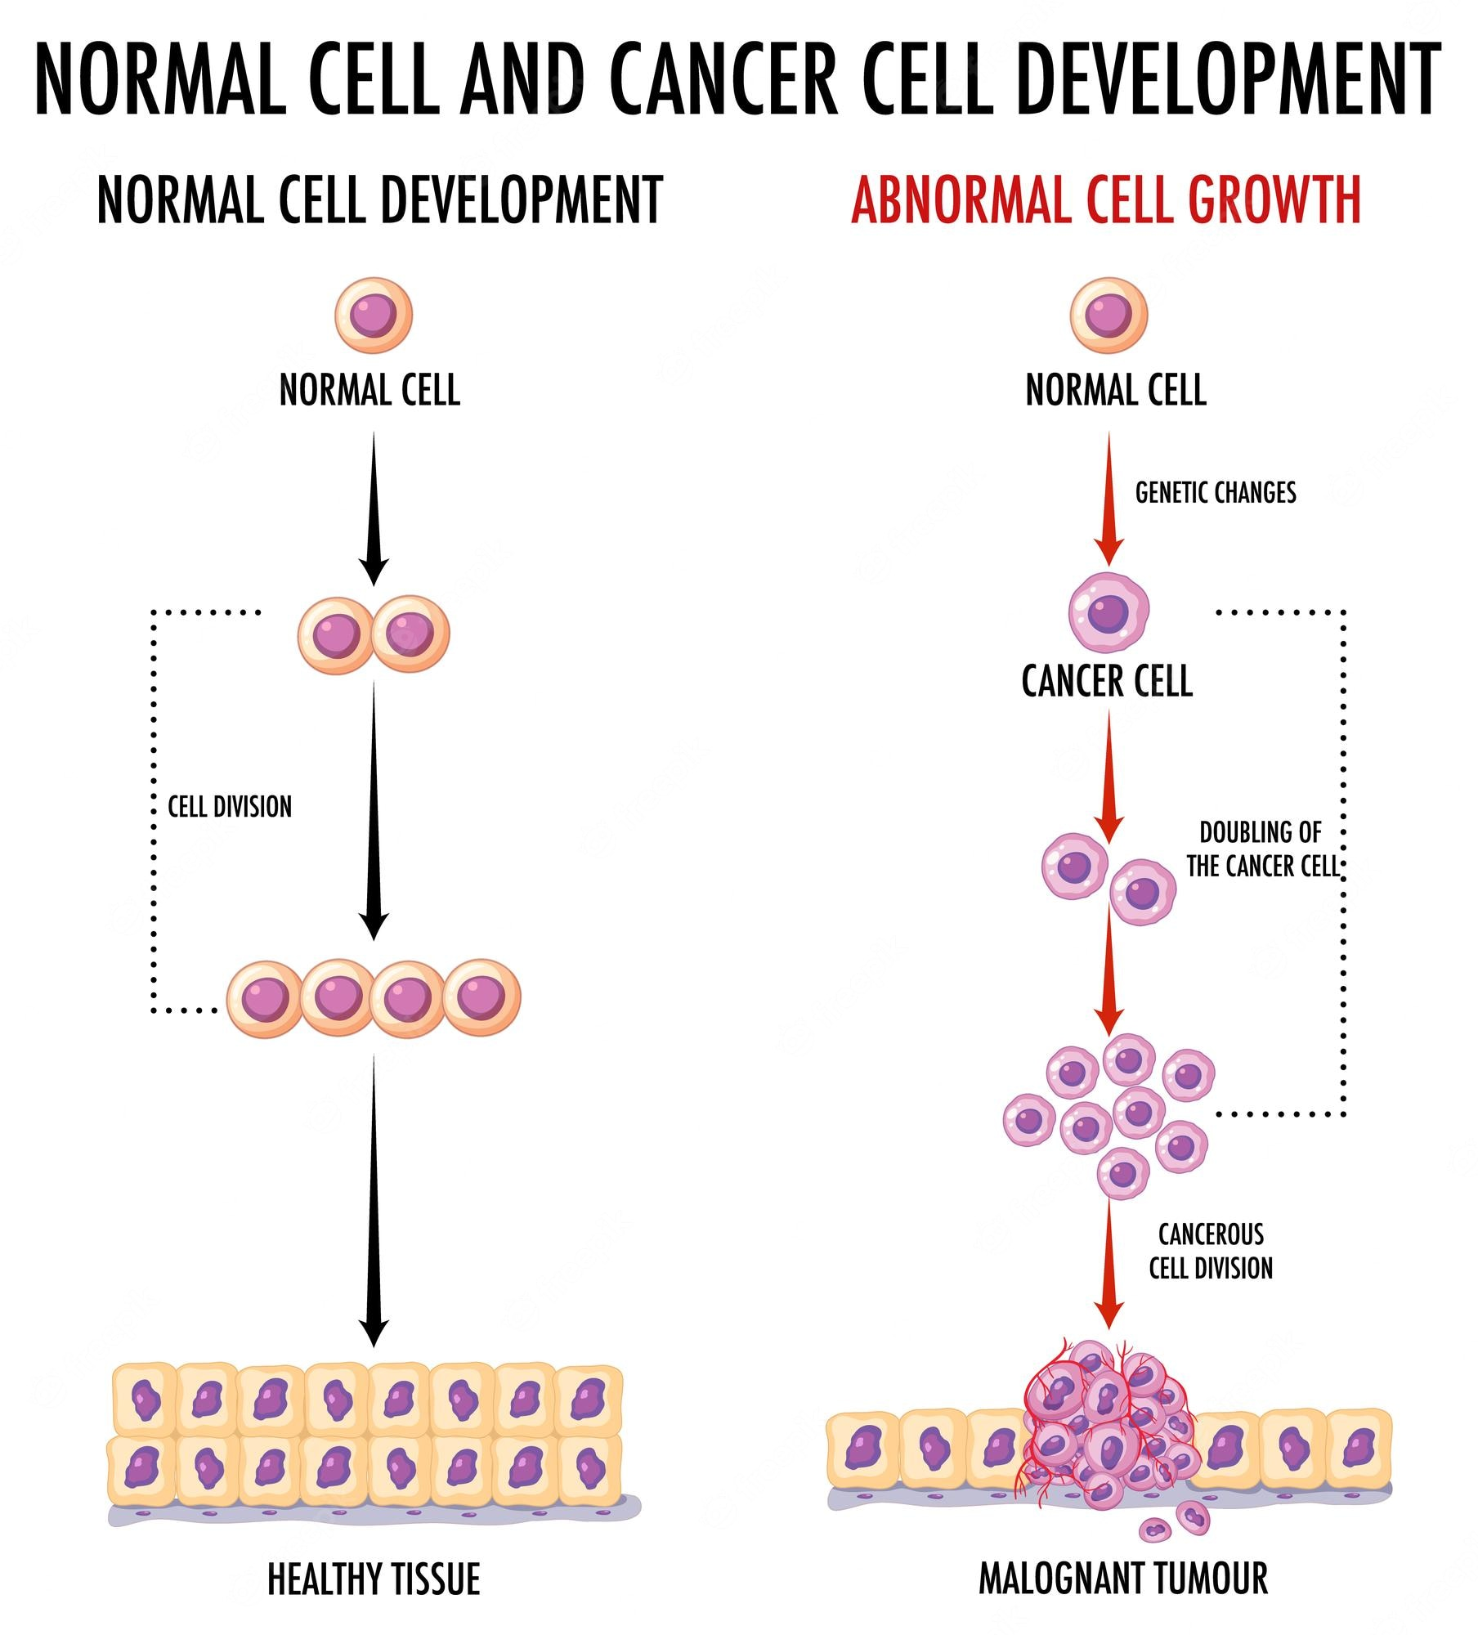
Normal Cell to Cancer Cell
-Cancer: any disease among many diseases characterized by the development of abnormal cells that divide uncontrollably.
- Cancer is a major cause of death worldwide and is the leading cause of death for 10 million people, or approximately one death in every 6 deaths.

Slide 7
Problems

Slide 8
Problems
-Centers interested in diagnosing and treating tumors have a set of problems:
1) Booking Appointments 2) Diagnosis & Treatments 3) Paper Records

Slide 9
Solutions

Slide 10
We made android application to solve the problems: 1- we facilitate the process of booking appointment. 2- we used deep learning model to predict drug effectiveness based on genomic data. 3- we made patient records digital to be updated easily.

Slide 11
Analysis

Slide 12
Requirements that specifies criteria that can be used to judge the operation of a system
Scalability
Responsiveness
Usability
Reliability
Security
Availability

Slide 13
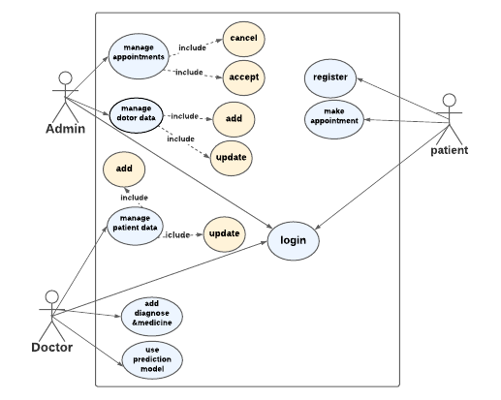
Use Case Diagram
give us an overview on the system including the actors, in our system are (doctor, patient, and admin) and the main process that each actor can do.

Slide 14
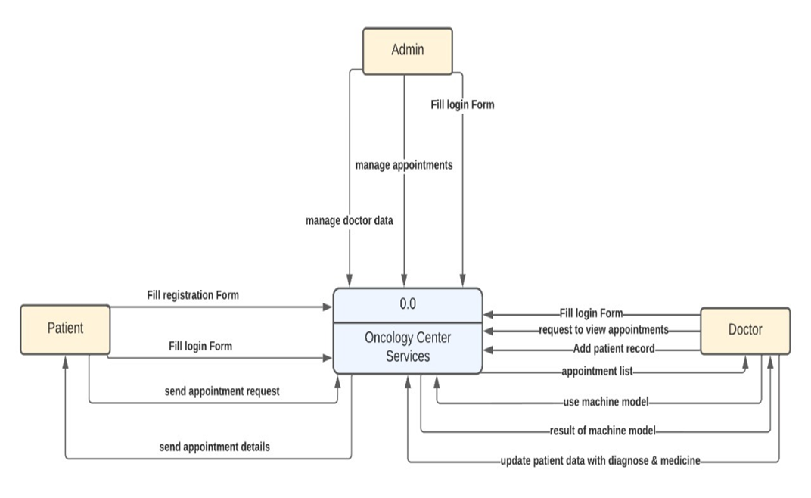
Context Diagram
showing the entities that interact with it (patient,
Doctor, and admin) and represent the flow of the data between the system and each external entity

Slide 15
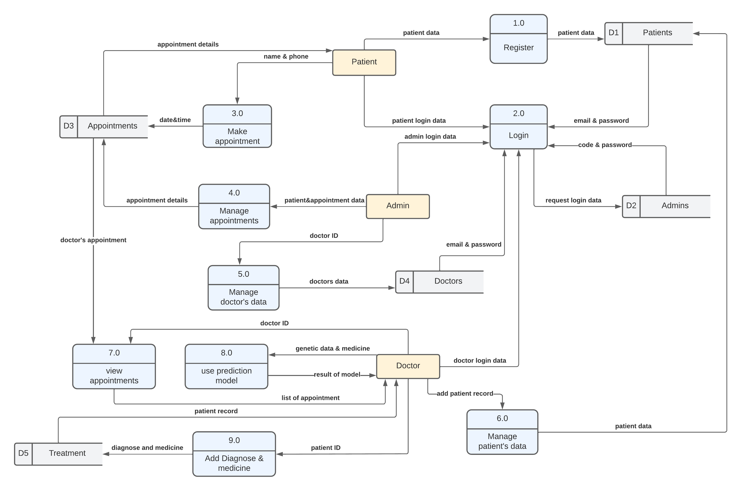
DFD level 1
DFD Level 1, they go into more detail than a context diagram.

Slide 16
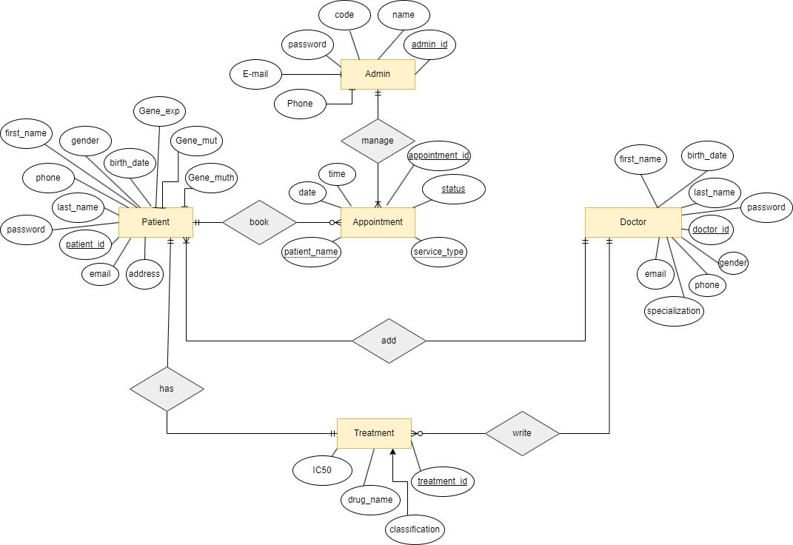
ERD

Slide 17
Dataset:
We have integrated two public databases in our study: GDSC and CCLE
In our study, we operate on 561 genes and 223 drugs

Slide 18
GDSC database provide us:
-Half-maximal inhibitory concentration (IC50): is the most widely used and informative measure of a drug's efficacy. It indicates how much drug is needed to inhibit a biological process by half,
- when IC50 value is small, it is evidence that the effectiveness of the drug is high.

Slide 19
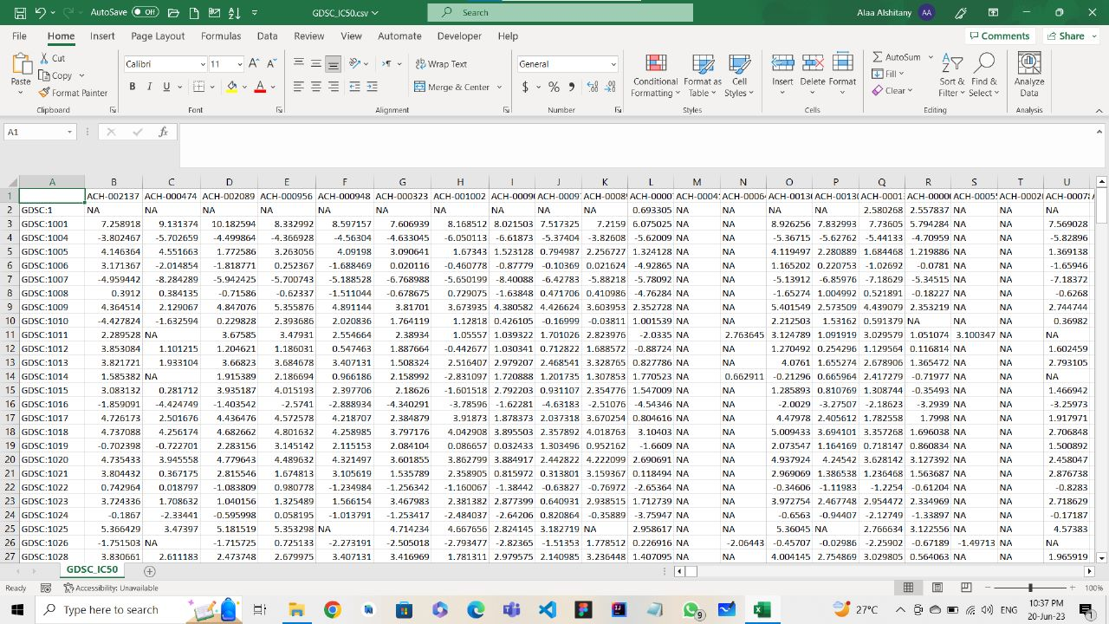
GDSC database:
Rows>> Drugs 223
Column>> Cell Line 561
Numbers>> value of IC50

Slide 20
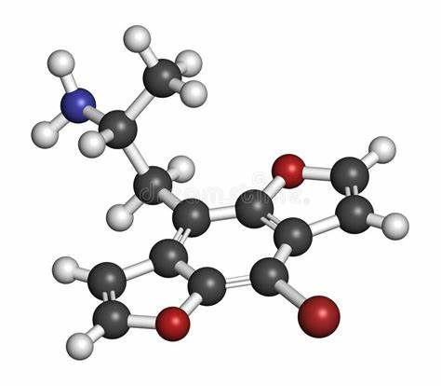
Drug Representation
Drug represent in 3D structure

Slide 21
CCLE database provide us:
Genomic, transcriptomic and epigenomic data of more than a thousand cancer cell lines. For the three data omics, we focused on gene mutation data, gene expression data, and DNA methylation data.
1. Genomic expression
2.Genomic mutation
3.Genomic methylation

Slide 22
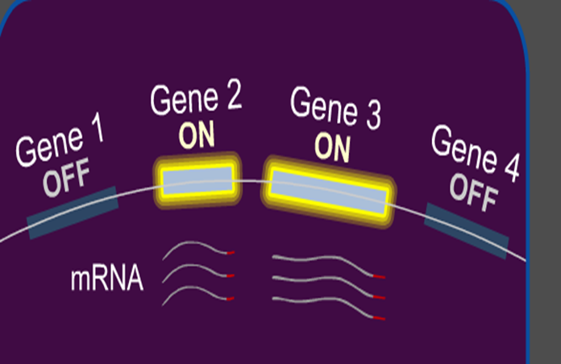
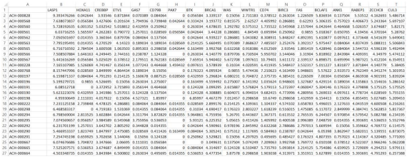
1. Genomic expression
is that process of turning on a specific gene to start making messenger RNA.
Every cell in our body contains a copies of each of our 20,000 genes.Different genes are turned “ on “ or “ off “ in different cell types
Rows>> cell lines 561
Column>> coding gene 698
Numbers>> Gene Expression Ratio
Each cell contains a value that reflects the expression level of a gene

Slide 23
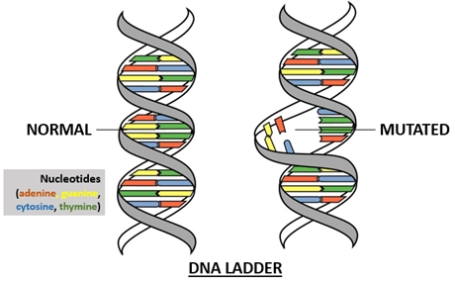
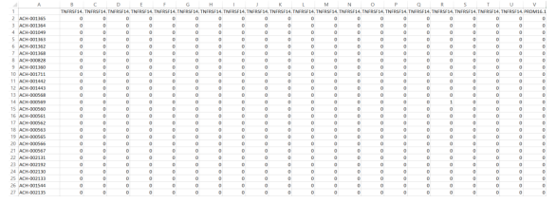
2. Genomic mutation:
are changes to your DNA sequence that happen during cell division.
Rows>> cell lines 561
Column>> mutation locus 16834
Numbers>> explain which mutation occur or not if equal zero

Slide 24
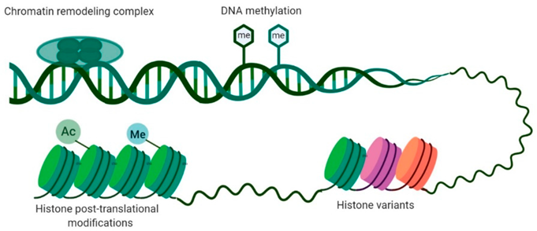
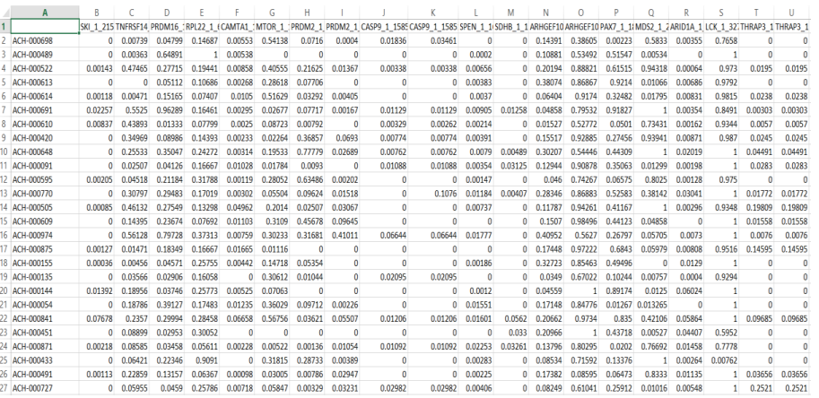
3. Genomic methylation
a biological process by which methyl groups are added to the DNA molecule. - changes in methylation pattern of genes can affect a person’s risk of developing disease such as cancer.
Rows>> cell lines 561
Column>> methylation locus 808
Numbers>> value that reflects the methylation level of a gene

Slide 25
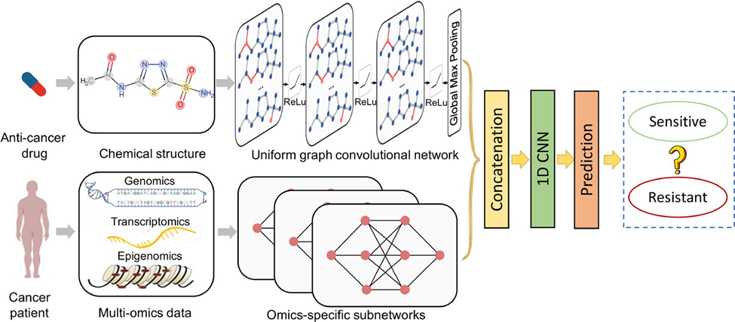
Model
➢ The goal of the model is to determine if the drug is effective for the cancer patient or not depends on cancer cell profiles (genomic mutation, gene expression and DNA methylation data) and structure of drug.

Slide 26
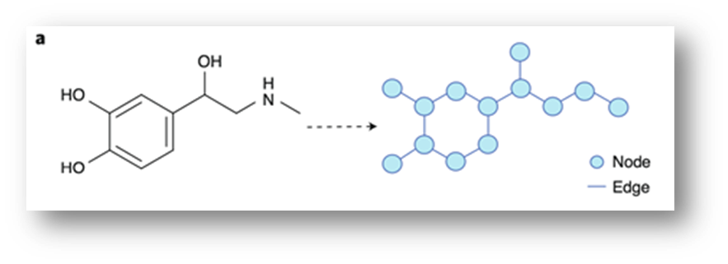
First Part:
Drug is represented as a graph based on the chemical structure before by the GCN.

Slide 27
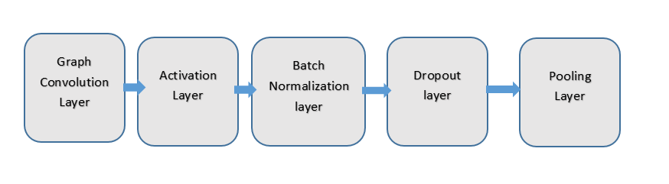
GCN
GCNs are a very powerful neural network architecture for machine learning on graphs.
Graph convolutional network (GCN) is a neural network that operates on graphs. Given a graph
G = (Nodes, Edges).
Used Learn the relationship between the molecular features of drugs.

Slide 28
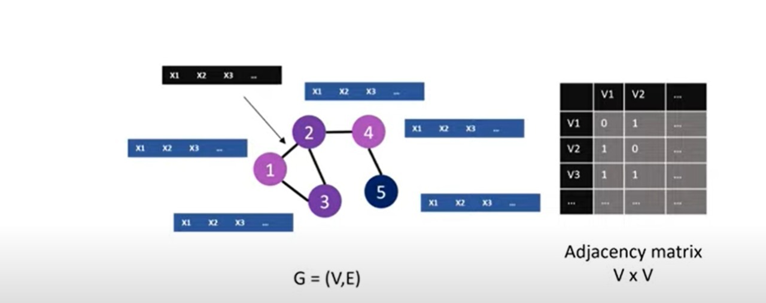
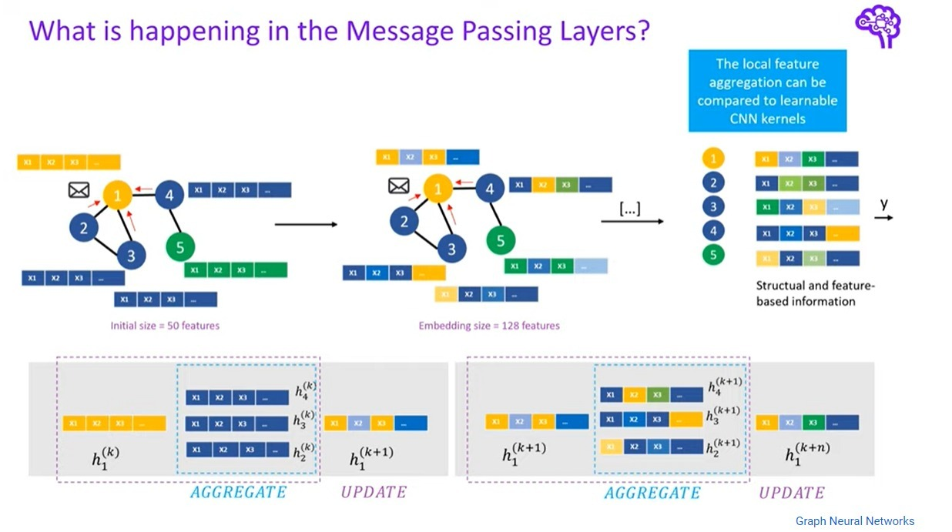
GCN Layers
For each node, we get the feature information from all its neighbours. Each node takes messages from other nodes in more than round which leads to all nodes know each other.

Slide 29
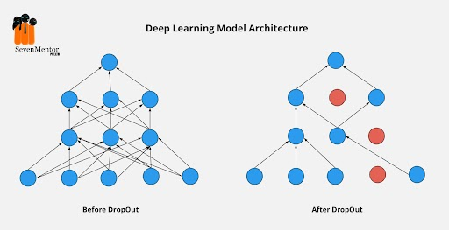
GCN Layers
Activation layer: This layer applies an activation function to the output of the GraphConv layer
RELU: F(X) = MAX (0, X) returns the input value if it is positive, and returns 0 if the input value is negative.
Batch Normalization layer: This layer normalizes the output of the previous layer to improve the stability and performance of the model.
y = gamma * (x - mean) / sqrt(variance + epsilon) + beta
Dropout layer: This layer randomly drops out a portion of the output of the previous layer during training to prevent overfitting.

Slide 30
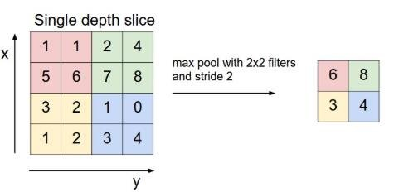
Pooling Layer: responsible for reduce the dimensionality of the feature matrix and improve the computational efficiency of the model by reducing the spatial size of the Convoluted Feature.

Slide 31
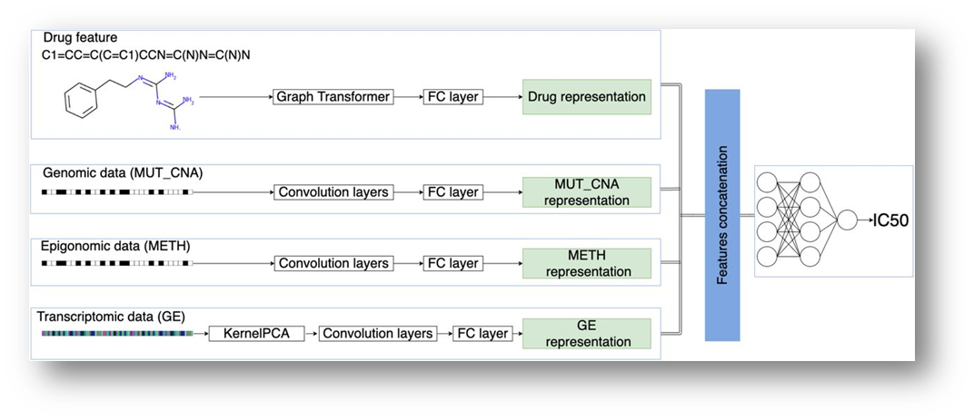
concatenate the network (multi-omics-data) and graph (drug), and fed to CNN.

Slide 32
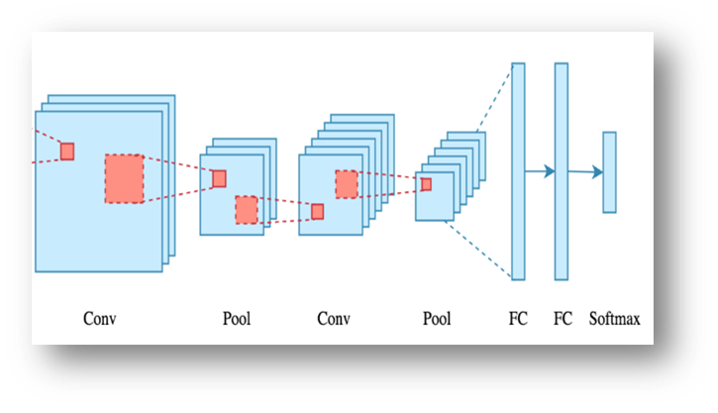
CNN
A convolutional neural network (CNN) is a class of deep neural network most commonly applied to analyze visual imagery.

Slide 33
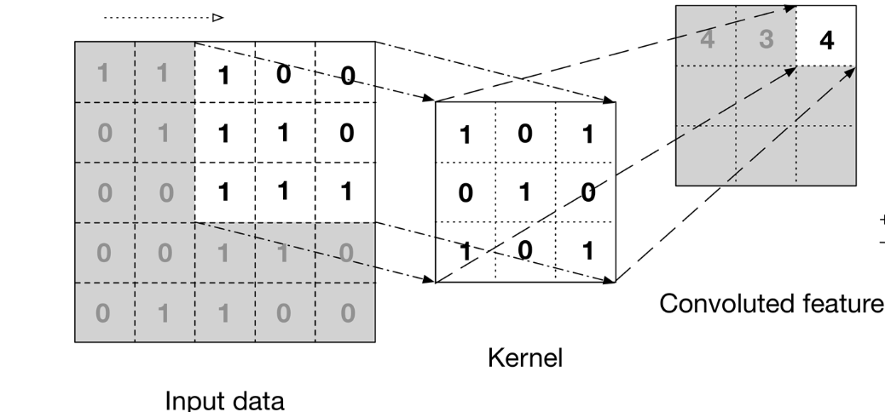
CNN
Convolution layer: convolutional neural network applies filter (kernel) to an input to create a feature map that summarize the presence of detected features in the input.
Filter: is a window that scans the image and enable CNNs to learn features from neighboring cells and take their value by training.

Slide 34
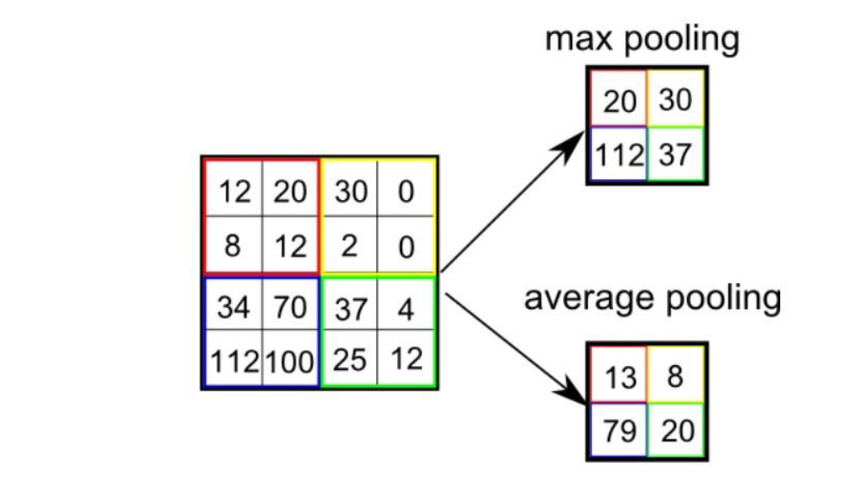
CNN
Pooling Layer: is responsible for reducing the spatial size of the Convolved Feature. This is to decrease the computational power required to process the data by reducing the dimensions. There are two types of pooling average pooling and max pooling.

Slide 35
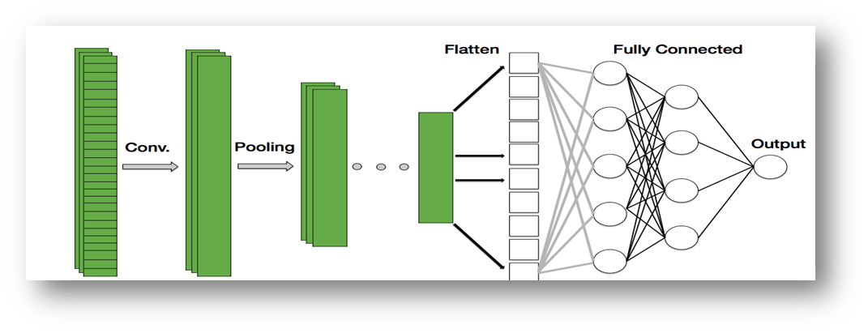
FCI Layer:
The feature outputs will be flatten to column vector and feed-forward it to FCL, then this vector will be inputs for neural network.
Finally the output is either a regression value (the drug sensitivity (IC50) or a binary classification probability (sensitive or resistant).

Slide 36
PreProccessing: 1) Clean Data 2) Normalization 3) Data Split

Slide 37
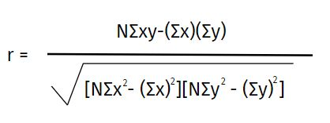
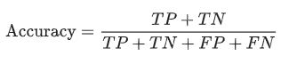
RESULTS

Slide 38
Results of Regression
IDE | Split the Data | Model | Pearson Correlation
Colab pro | Train_Test_Split | GCN | 0.9200
Colab pro | K_Fold | GCN | 0.9996
Colab | K_Fold | GCN with Linear_regression | 0.9965
Colab | K_Fold | GCN with Decision_Tree | 0.9967

Slide 39
Results of Classification
IDE | Split the Data | Model | Accuracy
Colab pro | Train_Test_Split | GCN | 0.8440
Colab pro | K_Fold | GCN | 0.9855
Colab | K_Fold | GCN with Logistic_regression | 0.9640
Colab | K_Fold | GCN with Random_Forest | 0.9596
Colab | Train_Test_Split | GCN with Random_Forest | 0.8762
Colab | Train_Test_Split | GCN with Logistic_regression | 0.8361

Slide 40
Data Base

Slide 41
We used Fire Base as : 1) It is a powerful tool for building mobile applications.
2) Its real-time data synchronization, scalability, ease of use, security.
3) Integration with other Firebase services make it an excellent choice.

Slide 42
Firebase
Real time Database
Authentication
Storage
Machine Learning

Slide 43
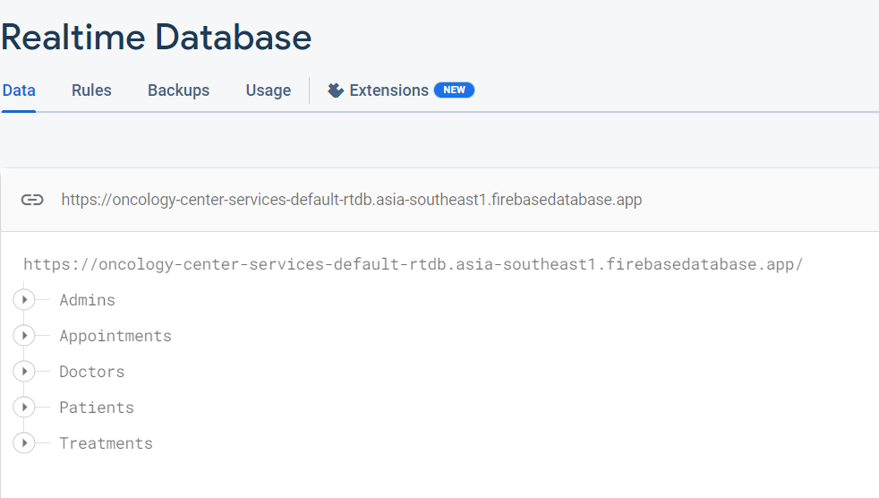
Firebase
Real time Database Firebase Realtime Database offers a free quota for its services. The free quota includes up to 100 simultaneous connections and 1 GB of data transfer per month.

Slide 44
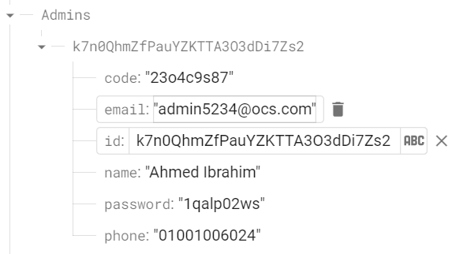
Firebase
Real time Database

Slide 45
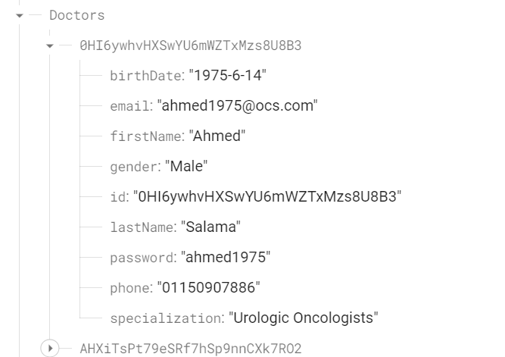
Firebase
Real time Database

Slide 46
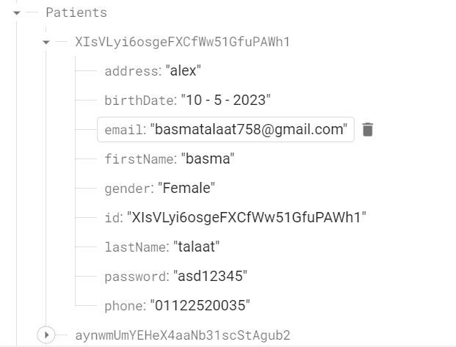
Firebase
Real time Database

Slide 47
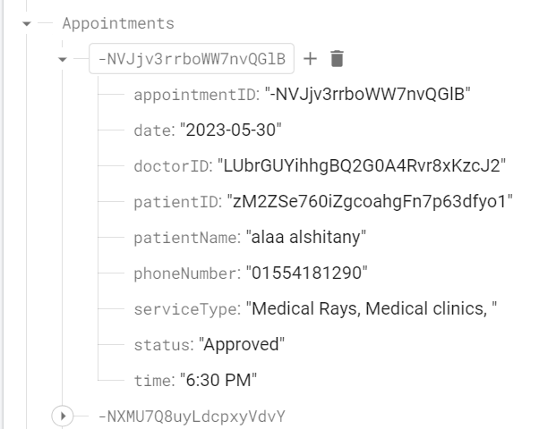
Firebase
Real time Database

Slide 48
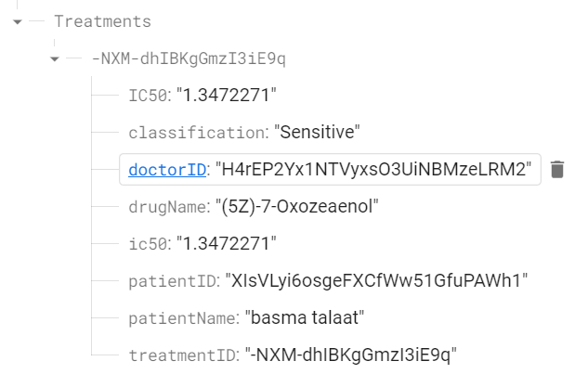
Firebase
Real time Database

Slide 49
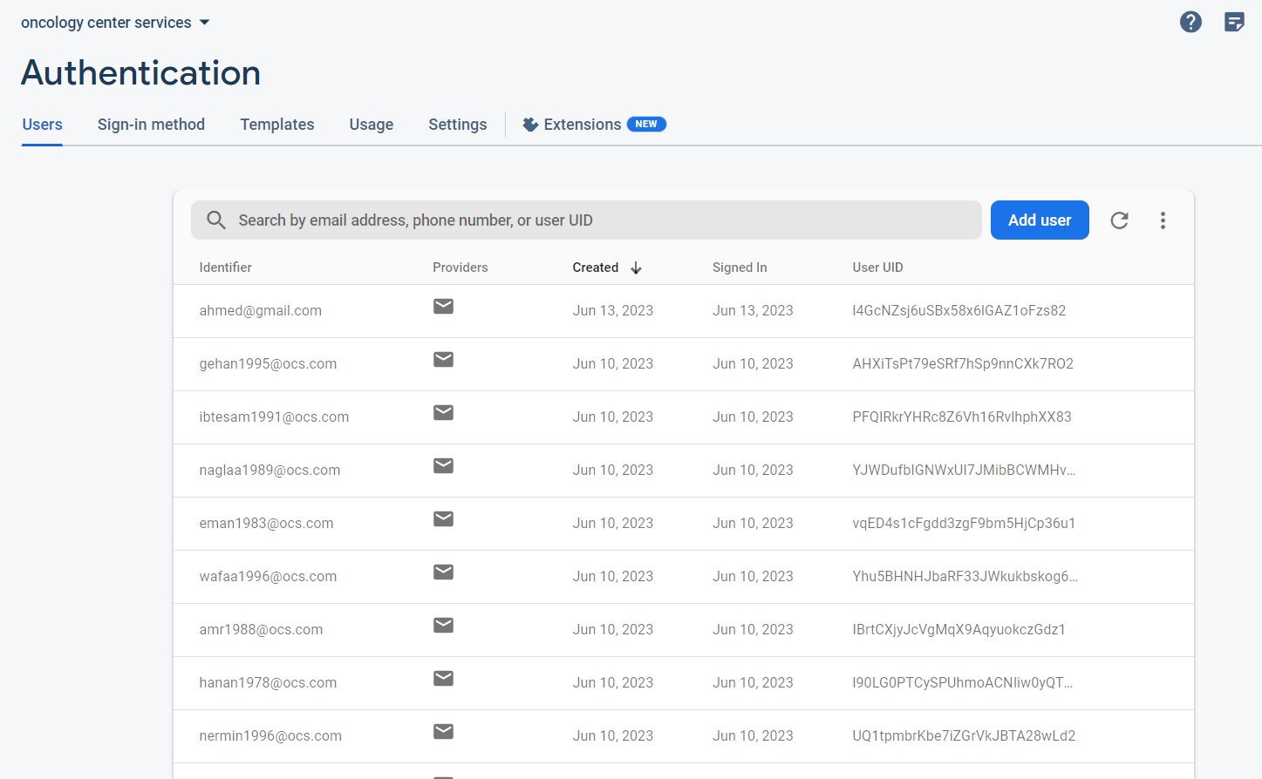
Firebase
Authentication: Firebase Authentication offers a free quota for its services. The free quota includes up to 10,000 monthly active users (MAUs) and 100,000 authentication operations per month.

Slide 50
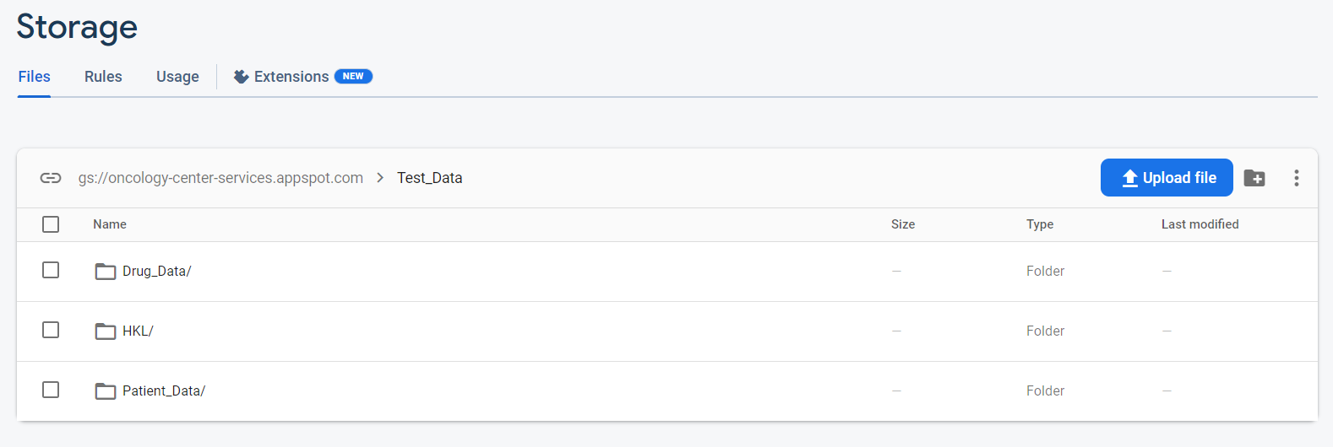
Firebase
Storage: Firebase Storage offers a free quota of 5 GB of data storage.

Slide 51
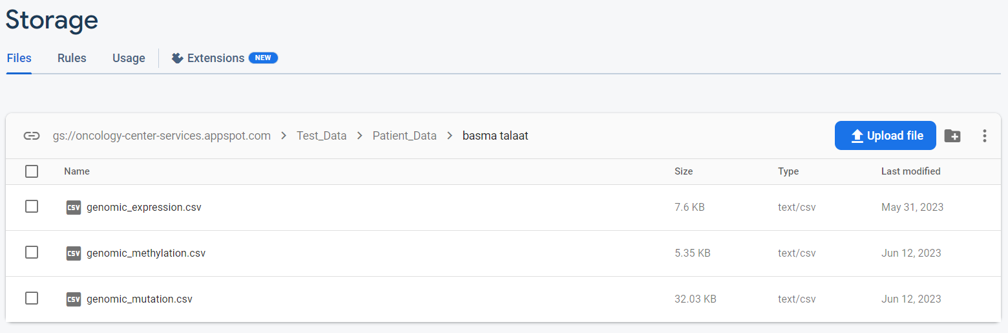
Firebase
Storage

Slide 52
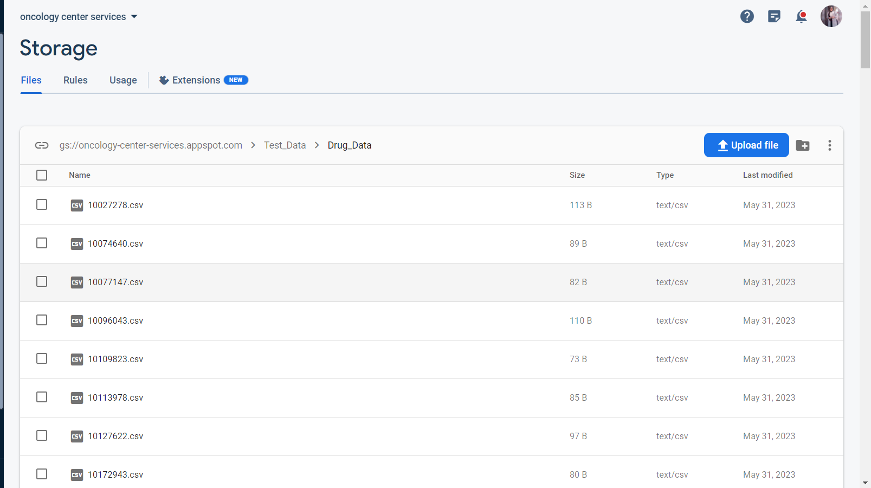
Firebase
Storage

Slide 53
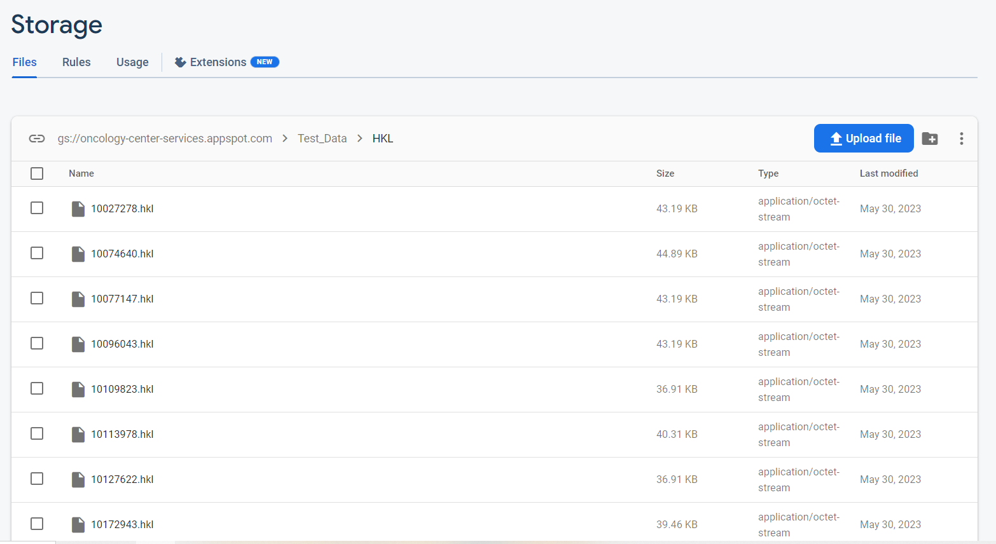
Firebase
Storage

Slide 54
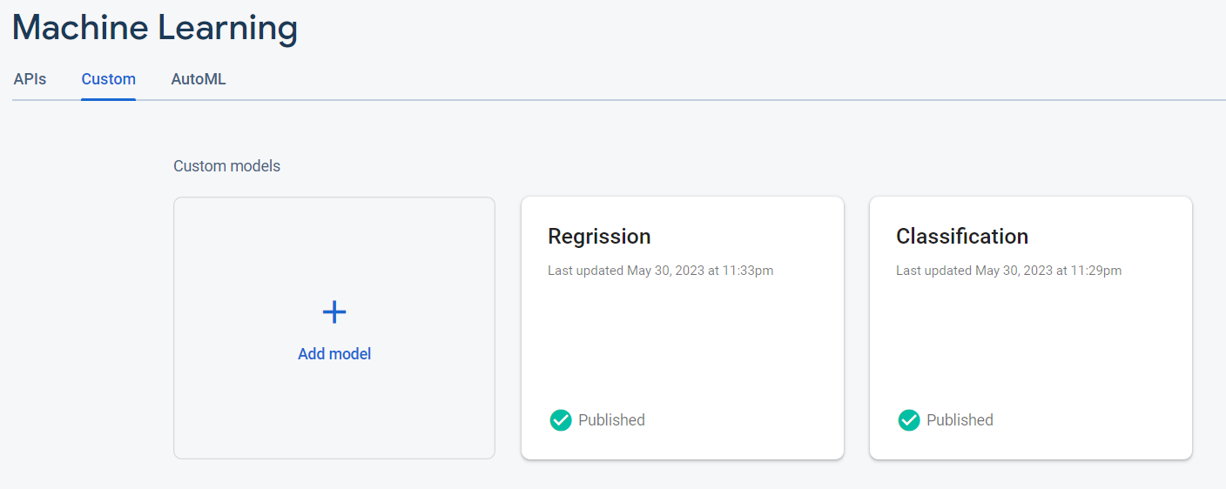
Firebase
Machine Learning

Slide 55
Implementation

Slide 56
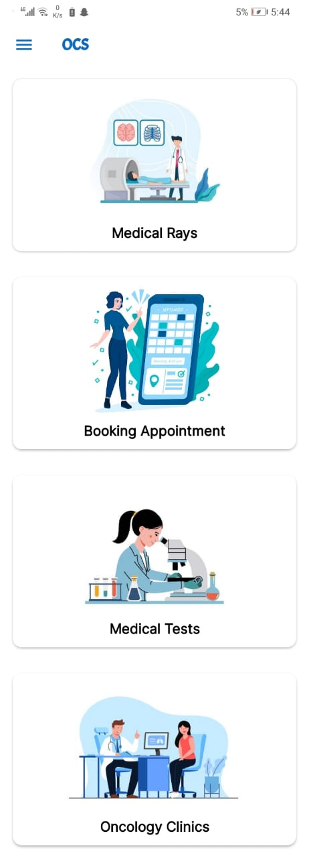
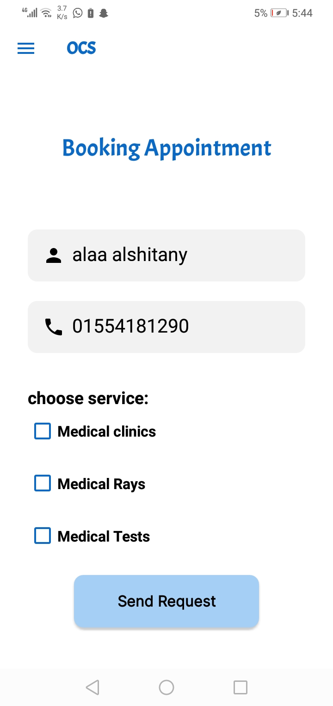
Booking Appointments
we have provided some solutions to most of the problems,by making an application that provide some facilitate for both doctor and patient.
For patient:
Services
booking online

Slide 57
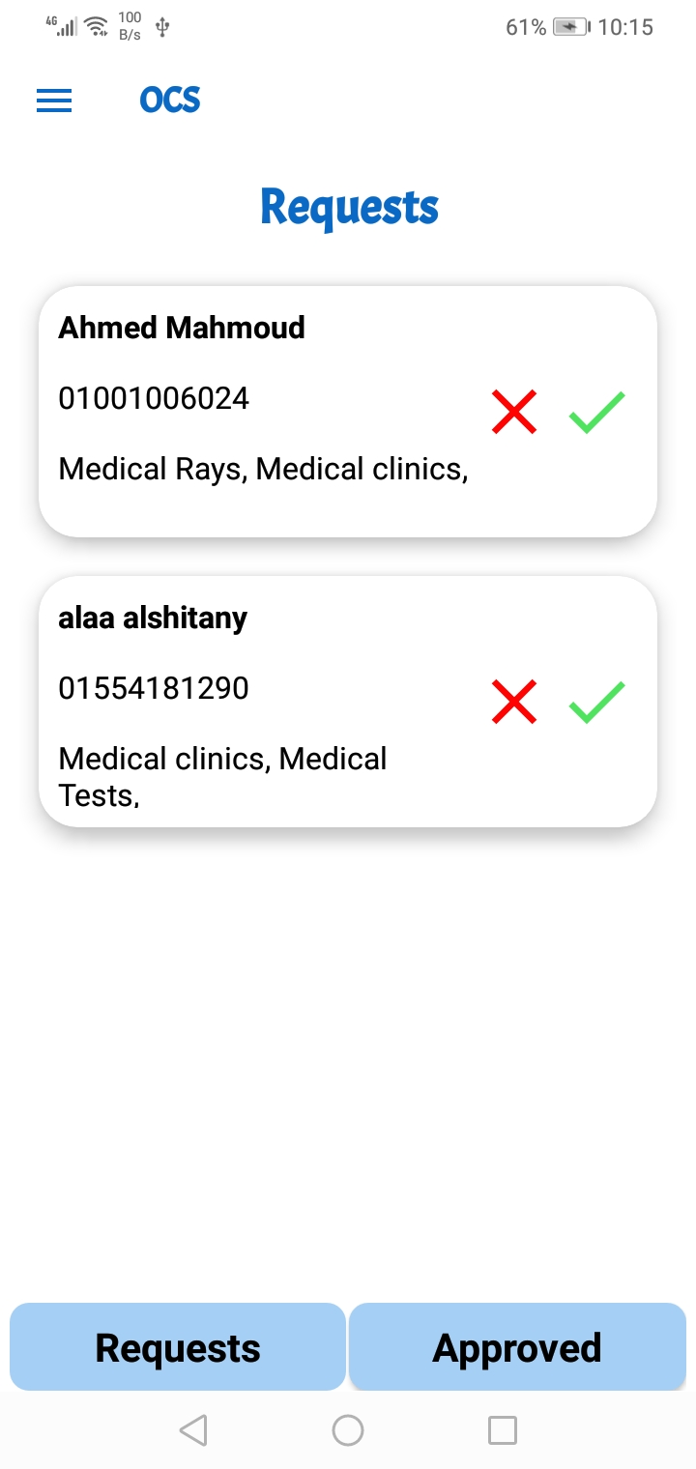
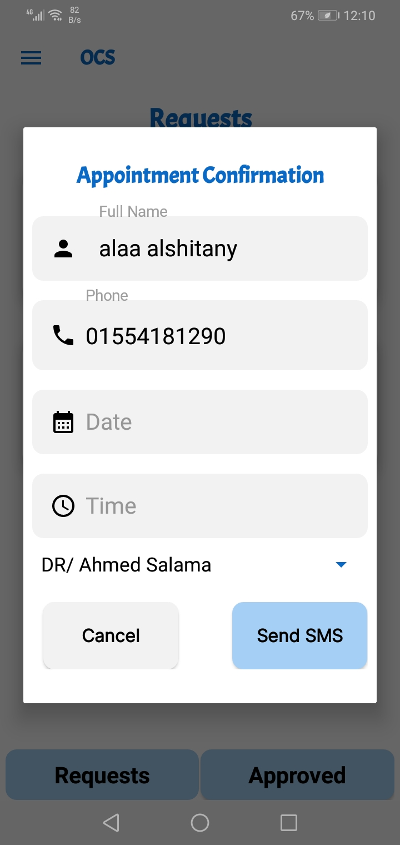
Booking Appointments
For organization & management:
Appointments
Requests

Slide 58
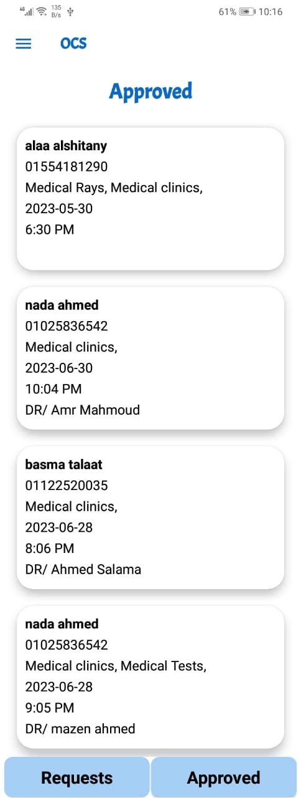
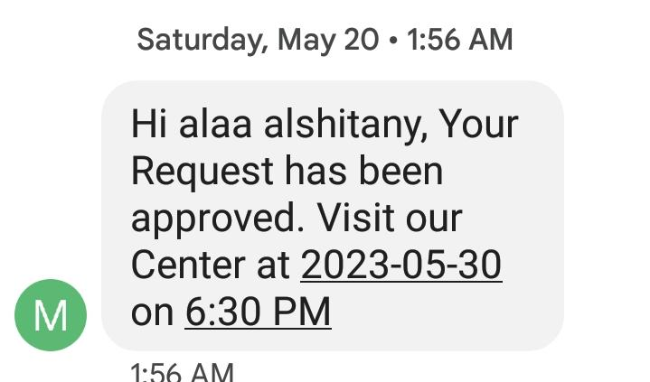
Booking Appointments
For organization & management:
Appointments
Requests

Slide 59
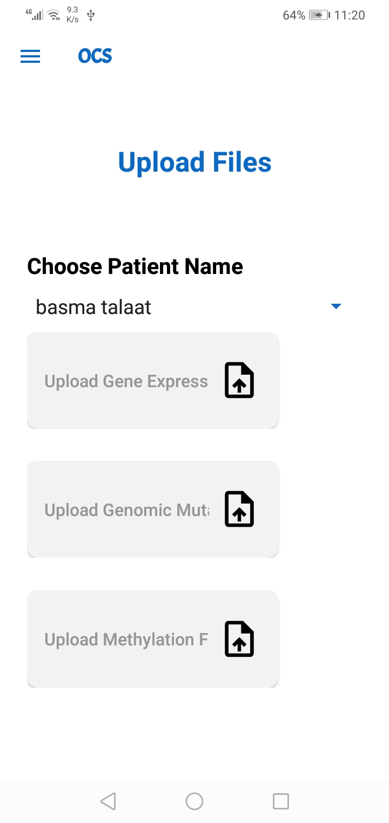
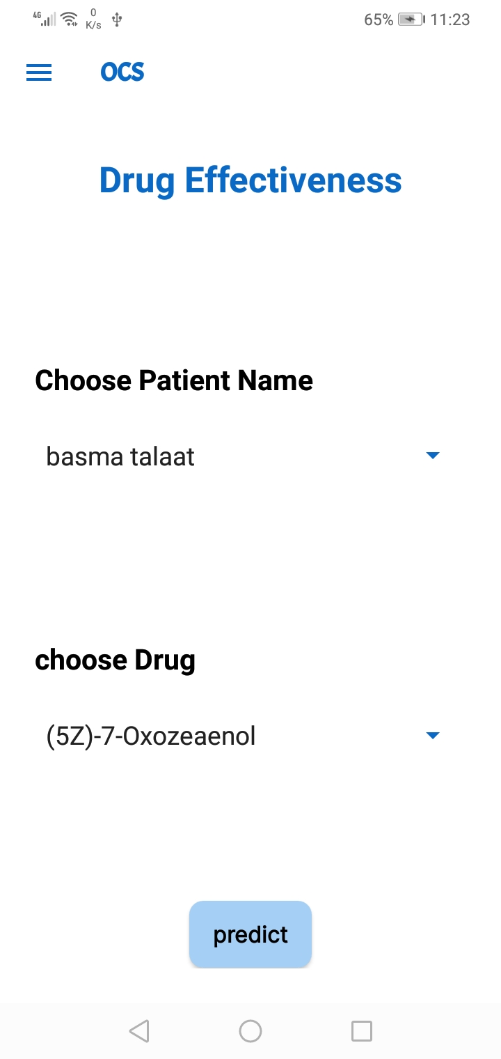
Diagnosis & Treatments
For doctor:
Use prediction model to predict drug effectiveness

Slide 60
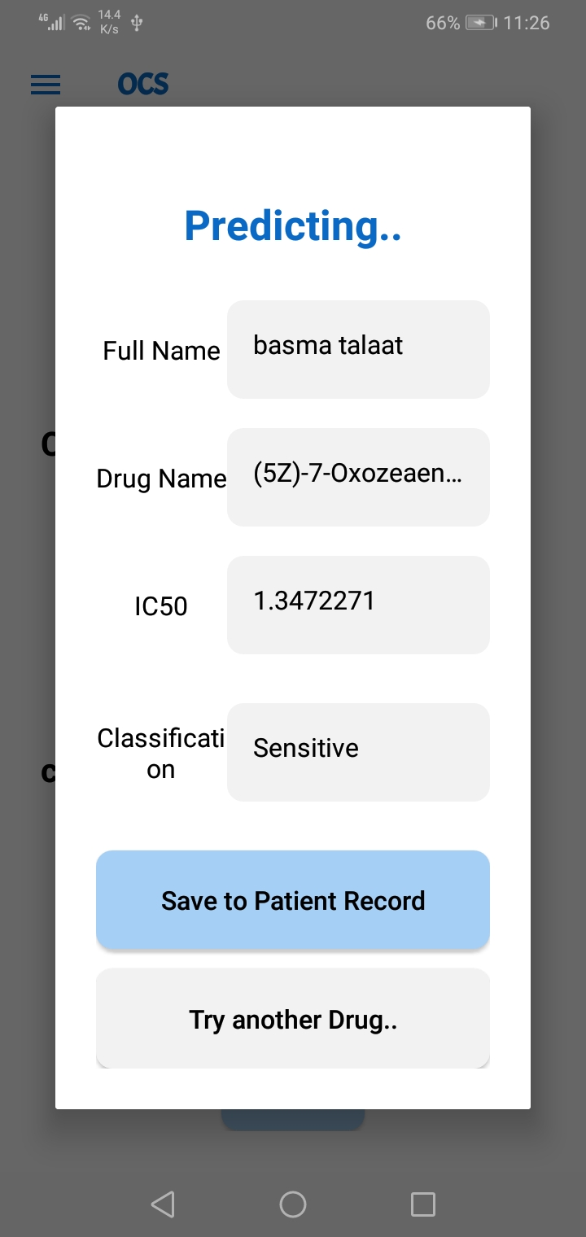
Diagnosis & Treatments
For doctor:
Machine model

Slide 61
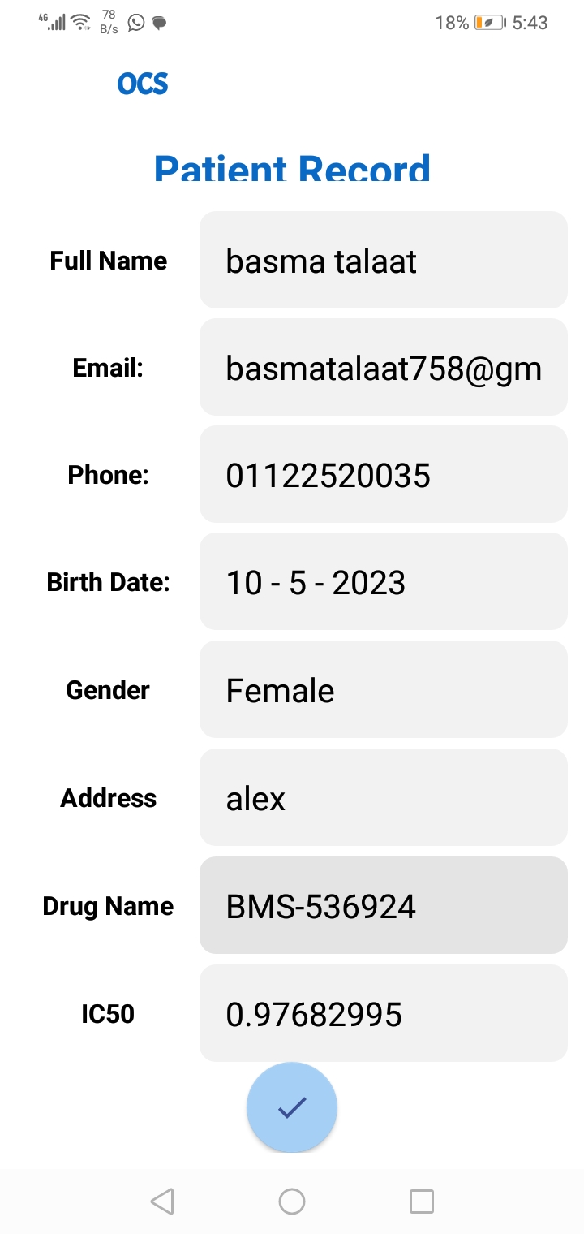
Paper Records
For doctor:
All patient records became digital.

Slide 62

Patient

Slide 63

Admin

Slide 64

Doctor

Slide 65
Future Work:
Add chat in app to facilitate communication between doctor & patient.
Uploading the app to server and publish it.
3) Add Machine model to help patient in diagnosis & treatment. 4) put marketing plan for the application. 5) Add payment method the the application.

Slide 66
Any Questions?

Slide 67
Thank You!

